Slide 1
Engine Characteristics
Basic engine performance characteristics
Prof. Amitava Datta
Jadavpur University
Power Engineering Department

Slide 2
Important Nomenclature
V_{c}
TDC
B
Cylinder bore (B), i.e. inner diameter
Stroke or stroke length (L)
Stroke to Bore ratio (L/B)
  L/B =1 : Square engine
  L/B > 1 : Under-square engine
  L/B < 1 : Over square engine (operates at higher speed)
Dead Center (TDC & BDC or IDC & ODC)
Displacement volume or swept volume (V_{s} = 0.7854B²L)
Cubic capacity (V_{s} × k, k=no. of cylinders in a multi-cylinder engine)
Clearance volume (V_{c})
Compression ratio: r= (V_{s}+V_{c)} / V_{c} = 1+V_{s}/V_{c}
V_{s}
L
Piston motion
BDC
for vertical cylinder
for horizontal cylinder

Slide 3
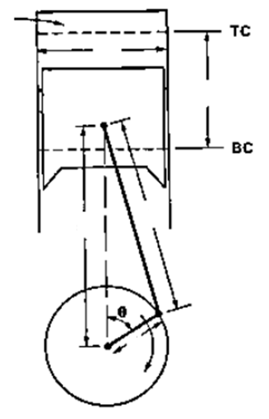
Piston Movement and Piston Speed
V_{C}
As the piston reciprocates within the cylinder, the volume inside the cylinder changes. The distance between the cylinder head and piston top as well as the distance between the wrist pin and crank shaft change, both at the same rate. The rate at which these distances (any of them) change is the piston speed.
B
Wrist pin
L
Connecting rod
C= length of the connecting rod
R = radius of the crank
x
C
a = C/R = ratio of connecting rod length to crank radius
a = 3 -4 for small engines
= 5-10 for large engines
Crank
R
x = distance between the wrist-pin and the crankshaft at a time when the crank makes an angle θ, with the cylinder centerline and θ=0 at TDC.
crankshaft
x = R cos θ + (C² – R² sin² θ)^{1/2} = R [cos θ + (a² –sin² θ)^{1/2}]
Instantaneous piston speed U_{p} = |dx/dt|

Slide 4
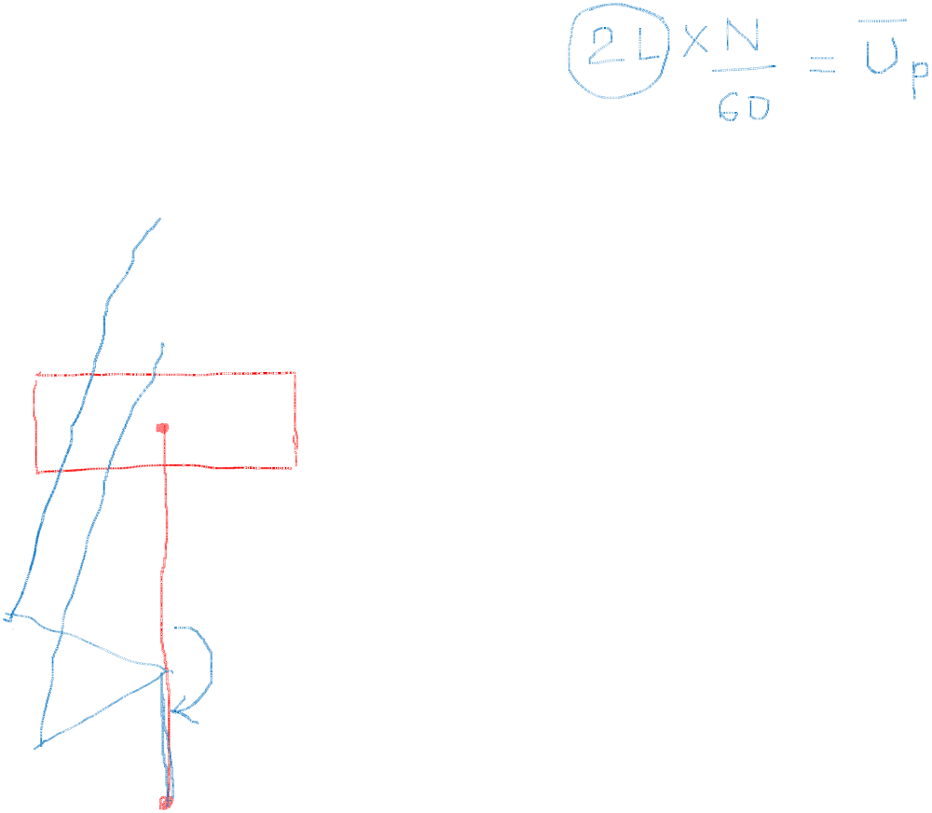
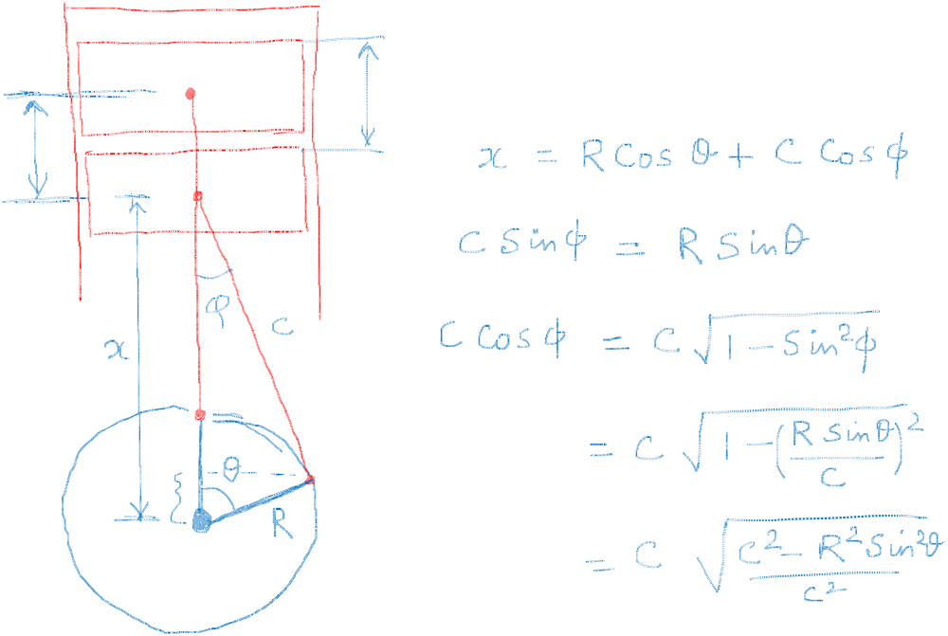

Slide 5
∴ U_{p} = R sinθ (dθ/dt) [1+cos θ/(a²-sin² θ )^{1/2}]
d θ/dt represents the rotational speed of the crank, which remains constant during the working of the engine.
However, the piston speed changes during the travel of the piston within the cylinder as the value of θ changes.
The mean piston speed is expressed as, U_{p}= 2 L N/60, where L is the stroke length and N is the RPM of the crank. The stroke length can be expressed as L=2R, i.e. double the crank radius. You can understand it from the movement of the piston between the to and bottom dead centers.
Again, dθ/dt = 2πN/60, which is the rotational speed.
Using the above, U_{p}/ U_{p} = (π/2) sinθ [1+cos θ/(a²-sin² θ )^{1/2}]

Slide 6
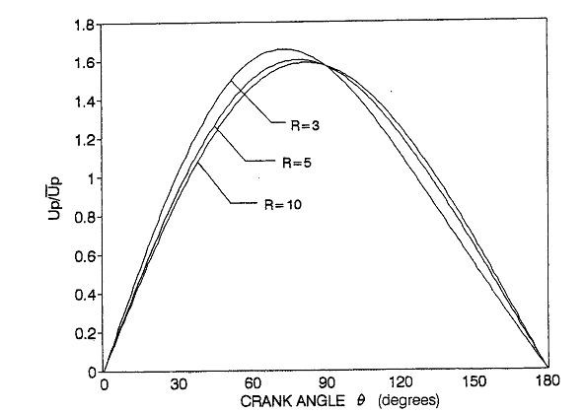
a =3
a =5
a =10
Variation of the instantaneous piston speed with crank angle for different values of a
Ref - Pulkrabek
Notice – i) instantaneous piston speed is 0 at θ=0 (i.e. TDC) and at θ=180° (i.e. BDC)
ii) ratio of instantaneous to mean piston speed is independent of
the engine RPM .

Slide 7
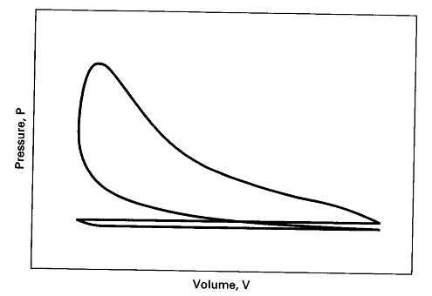
Work done in one working cycle of the engine
Carefully look at the figure. You can notice four strokes, i.e. piston movement between dead centers, to complete a working cycle.
Engine indicator diagram
compression
3
expansion
exhaust
1-2 – Suction
2-3 – Compression
3-4 – Expansion
4-1 – Exhaust
4
1
2
suction/intake
TDC/IDC
BDC/ODC
As the piston reciprocates within the cylinder, the volume inside the cylinder changes. The volume V of the cylinder at any instant can be written as,
V = V_{c} + (π/4)B² (C + R - x) [see slide 2 and 3 for nomenclature]
As x changes with the crank angle θ, the cylinder volume also changes.
The pressure inside the cylinder can be measured using a pressure transducer and a plot of pressure versus volume will generate the above plot, known as indicator diagram.

Slide 8
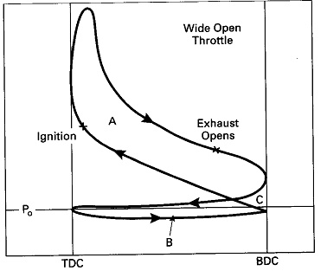

The net area under the p-V diagram or indicator diagram indicates the net work done by the gas on the engine piston during one complete working cycle.
The red area is the work done on the piston during expansion stroke. Here the gas pressure is high and it pushes the piston out to do positive work on the piston.
The blue area is the work done by piston on the gas during the compression stroke. The pressure of gas is somewhat high and the piston is pushing the gas and doing negative work on the piston.
The green area is the work done by the piston on the gas during the exhaust stroke. This work is expended in pushing the gas out as the piston moves in. So this is negative work on the piston.
The orange area is the work done by the gas on the piston during suction. This work is done as fresh gas is admitted into the cylinder which pushes the piston out.
p_{atm}
Volume, V
∴ Net Area = Red – Blue – Green + Orange
Thus the net area is the AREA ‘A’ minus AREA ‘B’. AREA ‘C’ cancels out in the process.
AREA ‘A’ is called the positive loop and AREA ‘B’ is called the negative loop or pumping loop.

Slide 9
∴ Net work done in one working cycle = p dV
= AREA ‘A’ – AREA ‘B’
four strokes
of indictor diagram
This work, which represents the net work done by the gas on the piston is called indicated work.
Net work done in one working cycle
Mean effective pressure =
Swept Volume or Displacement Volume
Area of the Indicator diagram
=
× Scale factor
Length of the Indicator diagram
Indicator diagram of a running engine can be obtained by fitting an indicator (mechanical or electronic) to the engine. The area of the diagram can be measured using a planimeter.
The above is also known as indicated mean effective pressure, IMEP (p_{imep})
So, Indicated work in one working cycle = p_{imep} × V_{s} = p_{imep} L A
where, A = cross-sectional area of the cylinder
Indicated Power (IP) = Indicated work in one working cycle
× No. of working cycles per sec

Slide 10
No. of working cycles per sec = N / (60n)
where, N = engine RPM or crank RPM, i.e. no of crank revolutions per minute
n=2 for 4-stroke engine, because in 4-stroke engine, two revolutions of crank corresponds to one working cycle
n=1 for 2-stroke engine, because in 2-stroke engine, one revolution of crank corresponds to one working cycle
p_{imep} L A N
So, IP =
60 n
p_{imep} L A N
For a multi-cylinder engine having ‘k’ cylinders,
IP =
× k
60 n
Remember, IP is the power generated at the engine piston due to the gas pressure in the cylinder.
We do not get this power at the crank shaft for useful purpose due to mechanical friction and parasitic loads of the engine. Parasitic loads include power for valve operation, oil pump, supercharger, air conditioner compressor, alternator etc.
The power available at the crankshaft for useful purpose is called Brake Power (BP)
BP is less than IP and the difference is known as Friction Power (FP)
IP = BP + FP
FP = IP − BP

Slide 11
Brake mean effective pressure, BMEP (p_{bmep}) is defined using the BP as,
p_{bmep} L A N
So, BP =
,for single cylinder engine
60 n
BP
BMEP
Mechanical efficiency η_{mech}=
=
IP
IMEP
Mechanical efficiency accounts for the performance of the engine in terms of mechanical (frictional) losses. High mechanical efficiency means that the losses are less.
Normally, at low engine speed, mechanical efficiency remains 80-85%; while for high speed engines it can be as low as 60%.

Slide 12
Significance of Engine Mean Effective Pressure
Mean effective pressure is an engine parameter which can be used to compare engine output independent of engine size and speed.
A larger engine will generate higher torque at the crankshaft while at high RPM the power output will increase.
Engine Torque or Brake Torque (T)
Torque is the ability of the engine to do work overcoming the external resistance.
2 π N T
BP =
where, N is the engine RPM
60
For a particular engine, brake torque and brake power do not reach the peak simultaneously at the same RPM. The peak torque is reached at lower RPM than peak power.

Slide 13
2 π N T
p_{bmep} L A N
BP =
=
60
60 n
p_{bmep} V_{s}
So, torque at the crankshaft
T =
2 π n
Both engine torque and power are functions of engine speed (RPM). At low speed, torque increases as engine speed increases. This is because with the increases in engine speed, piston speed increases. So the velocity with which air is admitted increases. Thus more air gets in during the suction stroke, enabling the burning of more fuel and increase in the mean effective pressure. As both torque and speed increases, engine powers (both IP and BP) also increase.
As the engine speed increases further, torque reaches a maximum value and then decreases. Torque decreases as the engine becomes unable to take in the full charge of air at higher speed due to restrictions imposed by the valves. IP increases with the increase in speed, but BP increases to a maximum and then decreases at higher speed.

Slide 14
Thermal Efficiency
Thermodynamic performance of the engine is expressed using thermal efficiency. From the common definition of a heat engine, thermal efficiency is the ratio of Power Output and Rate of Heat Input
Based on whether the power is IP or BP, we have two thermal efficiencies.
IP
Indicated Thermal Efficiency η_{ith}=
m_{f} × HV
BP
BrakeThermal Efficiency η_{bth}=
m_{f} × HV
m_{f}
= mass burning rate of fuel, kg/s, HV = heating value of fuel, kJ/kg
η_{bth}
Mechanical efficiency η_{mech}=
η_{ith}

Slide 15
Specific Fuel Consumption
Specific fuel consumption of an engine is the amount of fuel consumed per unit energy output. Therefore, it represents the fuel economy of the engine. Again, based on indicated or brake work, there can be two sfc.
m_{f}
Indicated Specific Fuel Consumption (ISFC)=
× 3600
IP
m_{f}
Brake Specific Fuel Consumption (BSFC) =
× 3600
BP
Normally, sfc is expressed in the unit of kg/kWh as in the above expressions.
ISFC
Mechanical efficiency η_{mech}=
BSFC

Slide 16
Prob. An engine with an indicated thermal efficiency of 25% and mechanical efficiency 75 % consumes 25 kg/h of fuel at a fixed speed. The brake mean effective pressure is 5 bar and the mean piston speed is 15 m/s. Assuming that the engine is a four stroke, single cylinder, square engine, determine the crank radius and crank speed in RPM. Take CV of fuel = 42 MJ/kg.
Solution
η_{ith}=25%, η_{mech}=75%, m_{f} = 25 kg/h=0.007 kg/s, p_{bmep}=5 bar = 500 kPa
U_{p}=2LN/60 = 15 m/s, hv = 42000 kJ/kg
Square engine, so, L=B
η_{bth} = η_{ith} ×η_{mech} = 0.25 × 0.75 = 0.1875
p_{bmep} L A N
P_{bmep} (π/4)B² (U_{p}/2)
η_{bth} =
BP
=
=
, here, n=2
m_{f} × HV
(m_{f} × HV) × (60 n)
(m_{f} × HV) × n
0.1875 × 0.007× 42000 × 2
∴ B = L = 0.1935 m
B² =
500 × (π/4) × (15/2)
Crank radius = L/2 = 0.0967 m = 96.7 cm
N = (U_{p}× 60)/(2L) = (15×60)/(2 ×0.1935) = 2326 RPM

Slide 17
Prob. In a performance test on a four cylinder, four stroke engine, the indicator diagram area was found to be 5×10⁻⁴ m² and the length of the indicator diagram was 0.05 m. If the y-axis has a scale of 1 m = 50 MPa, find the IMEP of the engine given that bore = 150 mm, stroke = 200 mm. The measured engine speed was 1200 RPM. Also calculate the IP and ISFC of the engine if the fuel injected per cycle is 0.5 cm³ with a specific gravity of 0.8.
Solution
Area of Indicator Diag. = 5×10⁻⁴ m², Lgth of diagram = 0.05 m, Scale Factor = 50 Mpa/m
B=0.15 m ,L=0.2 m, N =1200 RPM, Fuel injected/cycle= 0.5 cm³, fuel density = 0.8g/cm³
Area of the indicator diagram
× Scale Factor
IMEP = p_{imep} =
Length of the indicator diagram
5×10⁻⁴
× 50
= 0.5 MPa
=
0.05
p_{imep} L A N
IP =
× k
= 0.5 ×1000×0.2×(π/4) ×0.15²×(1200/(2×60))×4 = 70.7 kW
60 n
Fuel consumption per sec. = Fuel consumed in one working cycle × No. of cycles/sec
= (0.5×0.8/1000) × (1200/(60×2)) = 0.004 kg/s
ISFC = (0.004 × 3600)/70.7 = 0.2037 kg/kWh

Slide 18
Prob. A four stroke, four cylinder automotive engine develops 150 N-m brake torque at 3000 RPM. Assuming BMEP to be 9.25 bar, find (i) brake power, (ii) displacement volume, (iii) stroke, (iv) bore. Take mean piston speed as 12 m/s.
Solution
T = 150 N-m, N = 3000 RPM, p_{bmep} = 9.25 bar = 925 kPa, n = 2, k = 4, U_{p}=12 m/s
2 π N T
2 π × 3000 × 150
BP =
=
= 47.12 kW
60 × 1000
60 × 1000
p_{bmep} L A N k
BP =
⇒ 47.12 = 925 × (L A) × (3000/(60×2)) × 4
60 n
⇒ (L A) = V_{S}= (47.12×120)/(925×3000 ×4) = 0.0005094 m³ = 509.4 cc
U_{p}= 2 L N/60
∴L = (U_{p}×60) / (2 N) = (12 × 60 ) / (2 × 3000) = 0.12 m = 120 mm
A = (π/4) B² = (V_{s}/L) = 0.0005094/0.12
Bore, B = 0.0735 m = 73.5 mm

Slide 19
Prob. A four stroke C.I. engine having a cylinder diameter of 39 cm and stroke of 28 cm has a mechanical efficiency of 80%. Assume the frictional power to be 80 kW. Its fuel consumption rate is 86 kg/h with an air-fuel ratio of 18:1. The speed of the engine is 2000 RPM. Calculate (i) IP, (ii) HV, if η_{ith}=40%, (iii) p_{imep} (iv) air flow rate, (v) mean piston speed.
Solution
B=0.39 m, L =0.28 m, η_{mech}=80%, FP=80 kW, m_{f} = 86 kg/h = 0.0239 kg/s
A/F = 18, N = 2000 RPM, η_{ith}=40%,
η_{mech}= (BP/IP) = 1 – (FP/IP), ∴ IP = FP/(1-η_{mech}) = 80 / 0.2 = 400 kW
η_{ith}=IP / (m_{f} × HV), ∴ HV = IP / (m_{f} × η_{ith}) = 400 / (0.0239 × 0.4) = 41840 kJ/kg
p_{imep} L A N
IP =
60 n
⇒ p_{imep}= (400 ×60×2)/(0.28×0.7854×0.39²×2000) = 717.5 kPa = 7.175 bar
Air flow rate = 18×86 = 1548 kg/h
Mean piston speed = 2 L N/60 = 2×0.28 ×2000/60 = 18.67 m/s

Slide 20
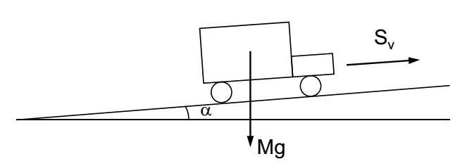
Vehicle Road Load Requirement
Consider, a vehicle running on a road. How much power the engine of the vehicle needs to develop?
The engine needs to develop power to overcome the resistances – frictional, aerodynamic drag and others.
Let us take the case of the adjacent figure, where a vehicle of mass M is climbing a slope of α. Let at the instantaneous velocity of the vehicle is V and acceleration is a.
V, a
Then, required brake power BP = (F_{R}+F_{D}+F_{I}+F_{C})V/η_{T}
F_{R}=Rolling friction at tires = C_{R} (Mg cos α); C_{R}=coeff. of rolling friction
F_{D}= Aerodynamic drag force = C_{D} (0.5 ρ_{a} A_{f} V²) ; C_{D}=Drag coeff., A_{f}=Frontal area; ρ_{a}=density of air
F_{I}= Inertia force = Ma; F_{C}=Mg sinα (for climbing up), = - Mg sinα (for climbing down)
η_{T} = transmission efficiency, i.e. efficiency with which power is transmitted from the crankshaft to the wheels

Slide 21
Prob. A car of 1250 kg mass is climbing a slope of 15°. The coefficient of rolling friction between the tire and the road is 0.015 and the coefficient of drag is 0.3. If the frontal area of the car is 2 m² and the transmission efficiency is 92%, find the brake power required to drive the car at a steady speed of 25 km/h. Take the density of air as 1.12 kg/m³.
Solution
M=1250 kg, α=15°, C_{R}=0.015, C_{D}=0.3, A_{f}=2 m², η_{T}=0.92, V=25 km/h=6.94 m/s
ρ_{a}=1.12 kg/m³
F_{R}=C_{R} M g cos (α) = 0.015 × 1250 × 9.81 × cos(15°) = 177.67 N
F_{D}=C_{D} (0.5 ρ_{a} A_{f} V²) = 0.3 × 0.5 × 1.12 × 2 × (6.94)² = 16.19 N
F_{I}= 0, as the car is moving at steady speed and not accelerating
F_{C}= Mg sin (α) = 1250 × 9.81 × sin(15°) = 3173.77 N
BP = (177.67+16.19+3173.77) × 6.94/0.92 = 25404 W = 25.4 kW

